Slide 1
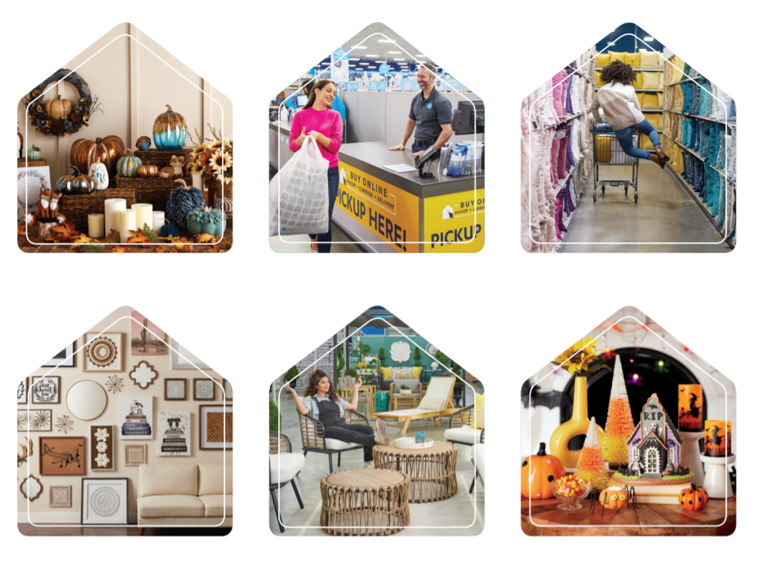


Final Group Project
ALY6980 Capstone Instructor Name: Yang Liu
Submitted on: July 1, 2021
By-
Yi Yuan,
Hanmin Zhang,
Houyuan Bai,
Reshma Sree Musalada,
Suvarna Suresh Tambe

Slide 2
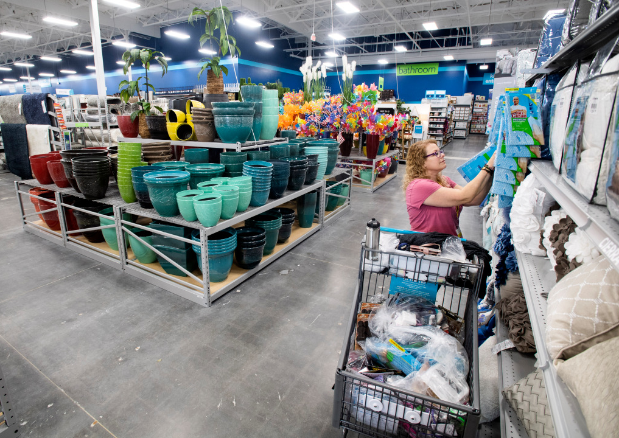
TABLE OF CONTENTS
1.Introduction
2.Literature Review
3.Business Question
4.Data
5.Methodology
6.Analysis
7.Conclution/Business recommendation
8.Bibliography

Slide 3
Introduction
The estimate sales in 2021 decreased because of COIVD-19. There are new challenges and opportunities in the home decorating and furnishing market, which makes AHG need to make new strategies to occupy the market. We want to figure out which factors can be used to predict sales and use the result to help AHG make more profit.
We used supervised method to build models and test them to get more accurate results. We also used python to visualize the data to make it clear.

Slide 4
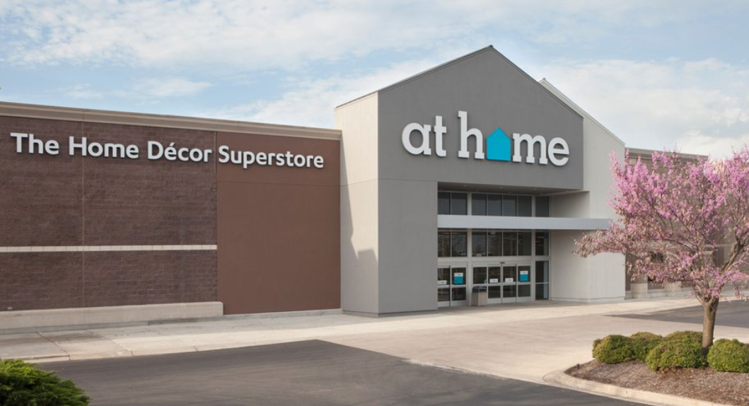

Overview of AHG
What is AHG？
The main business of AHG?
Marketing strategy

Slide 5
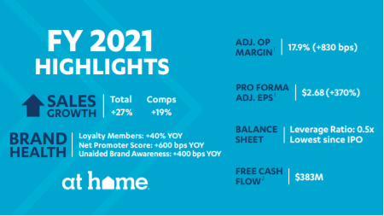
History and Company Overview
At Home (formerly known as Garden Ridge) was founded in 1979 in Garden Ridge, Texas, a suburb of San Antonio.
As for January 30, 2021 At Home store bean was comprised of 219 stores across 40 states.
They are focused on providing the broadest assortment of everyday and seasonal products for any room, in any style, for any budget.

Slide 6
Market trends
Rising number of houses increases the market
Physical retail stores stands more shares
Income drives the market
Growing influencing factors drive the market

Slide 7
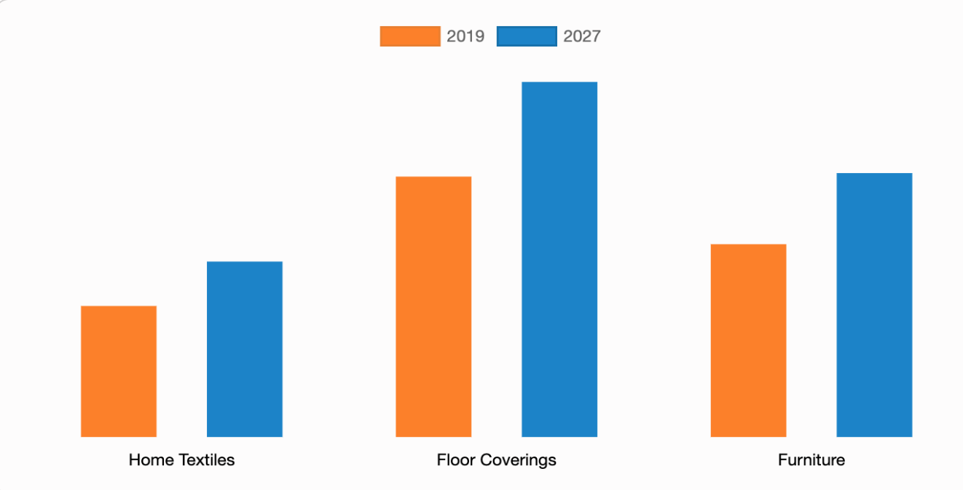
Rising number of houses
Due to fast-changing lifestyles and a rise in the number of house possessions, the United States home decor market is experiencing the highest growth, with a market share of more than 60% in the North American region.
rise in environment awareness among consumers has shifted their preference toward eco-friendly home decor products, which is a key growth factor of the global market.

Slide 8
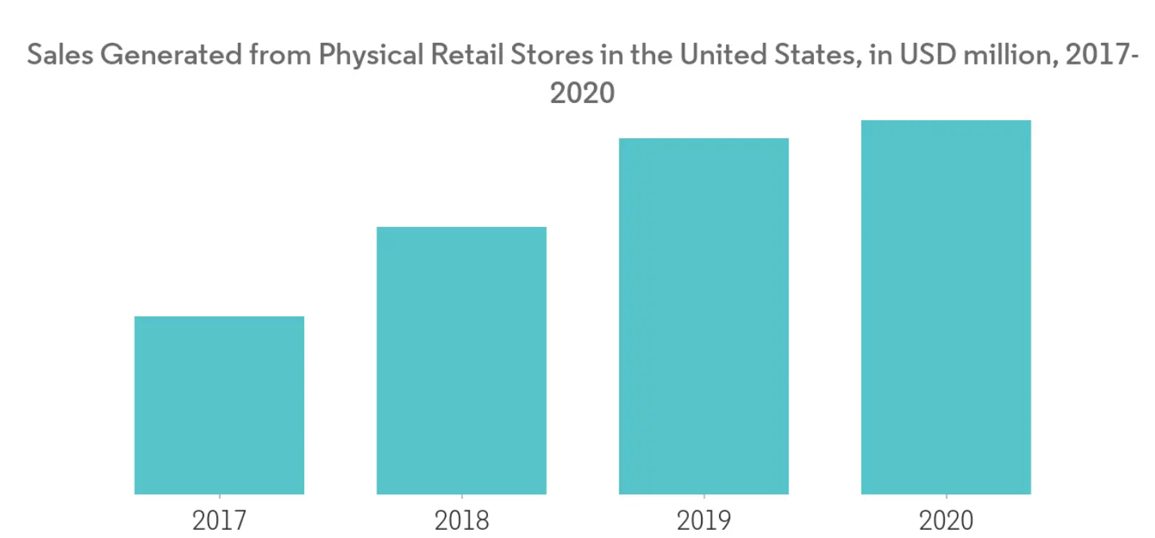
Physical retail stores account for a higher Share
The home furnishings retail industry allows consumers to make their homes truly their own with their very choices of furniture and decor.

Slide 9
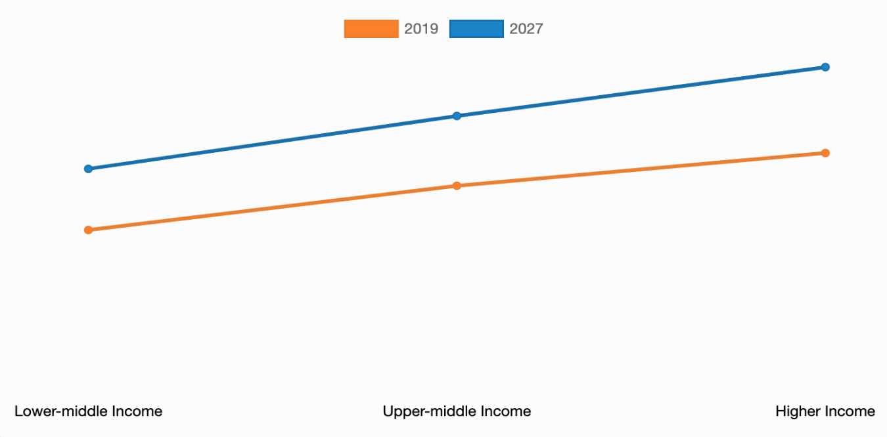
Income drives the market
The demand for home furnishings is cyclical, influenced by housing starts, as desires to remodel and redesign are not necessary during slow economic times. Demand is also driven by consumer income.

Slide 10
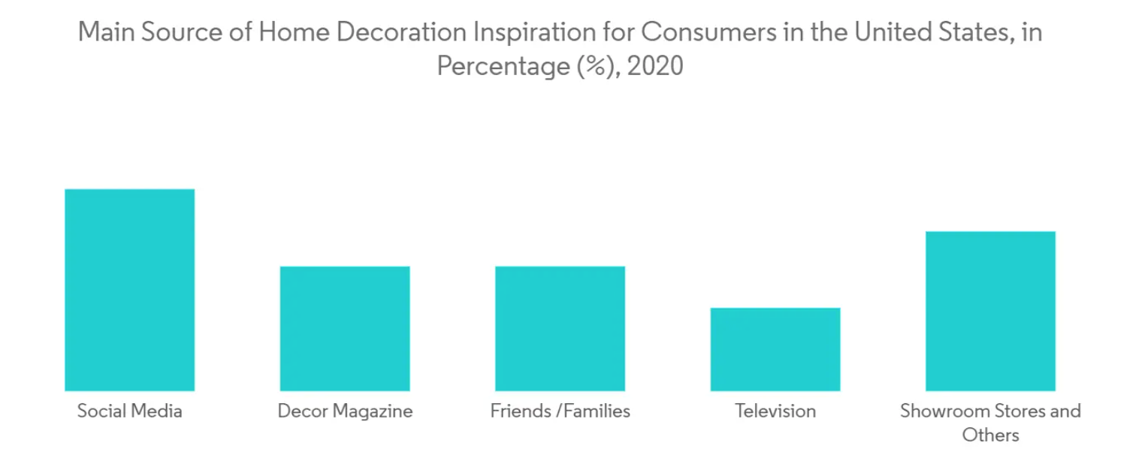
Growing influencing factors
Growing social media has become one of the influencing factors for the sales of home decorating products.
The manufacturers are also expanding their presence on social media platforms to get the new launches more familiar to the customers to make them purchase the products.

Slide 11
Literature Rivew
On-going trend
Threats and opportunity
Every-day low price strategy

Slide 12
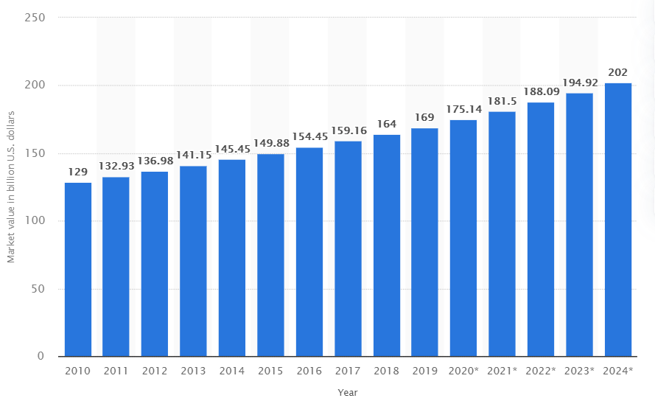
On-going trend
The improvement of urbanization leads to the increase of the number of new families. The home decor market valued at US$ 190.96 Billion in 2020
The strong performance of the online retail sector is also an important factor in promoting the development of this market, and the affordability and convenience have always been an important obstacle to the home decoration market .

Slide 13

Threats and opportunity:
Earlier this year, many stores closed because of the isolation policy of covid-19, which caused immeasurable losses to some parts of the retail industry.
According to Forbes, the struggle for home retailers will continue. For large retailers, they can increase the intensity of online sales, on the other hand, they can provide more displays, more collocations for people to choose, and provide appropriate consulting services, so that customers' experience in the store is irreplaceable.

Slide 14

Every-day low price strategy:
From the perspective of EDLP’s definition: according to Bell and Lattin, some retailers position themselves on the basis of “low prices, everyday” across a wide assortment of product categories, while others offer temporary deep discounts in a smaller group of categories (Bell and Lattin, 1998)
From the perspective of market factors and consumer factors: researchers found that consumer demographics are very important in choice of pricing strategies. Bailey (2008) found that sale proneness, store loyalty, and consumer income may affect consumer’s attitude toward EDLP. Bell et al.

Slide 15
AHG: Primary Goals
Run a consistent feature and profitable business
Create for consumers a self-help experience
Provide the largest house decor collection with high value
Expand the brand to create request
Increase the shop's base
Conduct competitive look for deals
Promote the brand and build awareness
To improve your purchasing experience by using digital solutions.

Slide 16

Business Questions
How the occupation related data affect sales?
How the race affect sales?
How the transportation affect sales?
Variables “Total house units”, “Total vacant houses” in that particular state has an impact on sales?
How the number of establishments might affect the sales?
What is the impact of every-day low price strategy on sale?

Slide 17
Data
Overview
Data preprocessing

Slide 18

Data Collection
External data source: data.census.gov
Cover three main topics:
Demographic
Work
Housing & Transportation
Aggregating level: years(2017-2019) & zip level (each record responds to zip level data in that particular year.)

Slide 19

Data
Demographic
Feature's name | Description
Total population | Total population in that zip area.
sex_ratio | The ratio of males per 100 females
white_race_percent | White race population percent.
Black_AfricanAmerican_race_percent | Black or African American race population percent.
AmericanIndian_Alaska_Native_race_percent | American Indian and Alaska Native race population percent.
asian_race_percent | Asian race population percent.
NativeHawaiian_OtherPacificIslander_race_percent | Native Hawaiian and Other Pacific Islander race population percent.
others_race_percent | Other race population percent.
more_race_percent | More race population percent.
NotHispanic_Latino_percent | Not Hispanic or Latino race population percent.

Slide 20

Data
Work
Feature's name | Description
# of workers over 16 | The number of the workers whose age is 16 and over.
Median_age | The median age of the workers whose age is 16 and over.
Median_earnings | The median earnings of the workers.
occupation_MBSA | The percentage of workers whose occupation is Management, business, science, and arts.
occupation_Ser | The percentage of workers whose occupation is services.
occupation_sales_and_office | The percentage of workers whose occupation is sales and office.
occupation_NrCM | The percentage of workers whose occupation is Natural resource, construction, and maintenance.
occupation_PTMm | The percentage of workers whose occupation is Production, transportation, and material moving.
class_private_wage_and_salary | The percentage of private wage and salary workers
class_government_workers | The percentage of government workers workers.
class_self_employed | The percentage of self_employed workers
class_unpaid_family_workers | The percentage of unpaid family workers

Slide 21
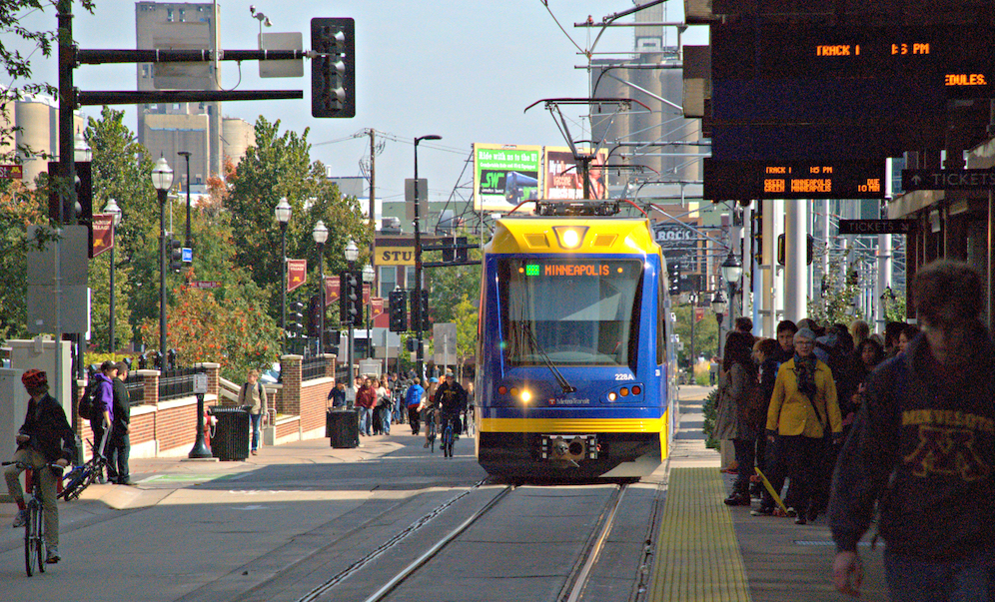
Data
Housing and Transportation
Feature's name | Description
mean_travel_time_to_work | Mean travel time to work(minutes)
owner_occupied_houseing_units | Owner occupied housing units (percent)
no_vehicle(percent) | Workers who don't have vehicle
public_transportation | Public transportation
occupied_housing_units | The number of occupied housing units
housing_built_2014+ | The number of housing built 2014 or later
num_of_establishments | The number of furnishing stores (This data is only available in 2017 and 2018)

Slide 22

Data Pre-processing
Missing Value
One store has been founded missing all data. (sol: deleted it)
Num_of_establishment missing 2019's data. (sol: fill the NA with 2018's data)
Mean_travel_time_to_work missing half of the data. (sol: fill the NA with median value of the same city)

Slide 23
Methodology
Tools used for this project:
1.Excel
2.Tableau
3.Python

Slide 24
Data is basically collected from "data.census.gov" website merging store data set with variables such as "Demographic", "Housing & Transportation" and few other variables related to population.
Further for visualization of data Tableau has been used. The data collected is loaded into the tableau server.
Later, for analysis the data is loaded into python and various predictive models have been used for analyzing and drawing insights from the data.

Slide 25
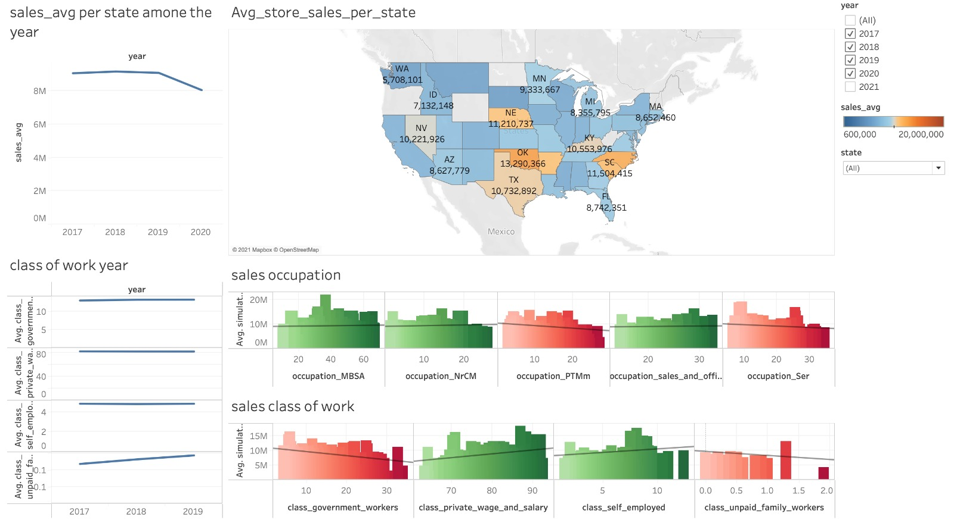
Data Visualization in Tableau

Slide 26
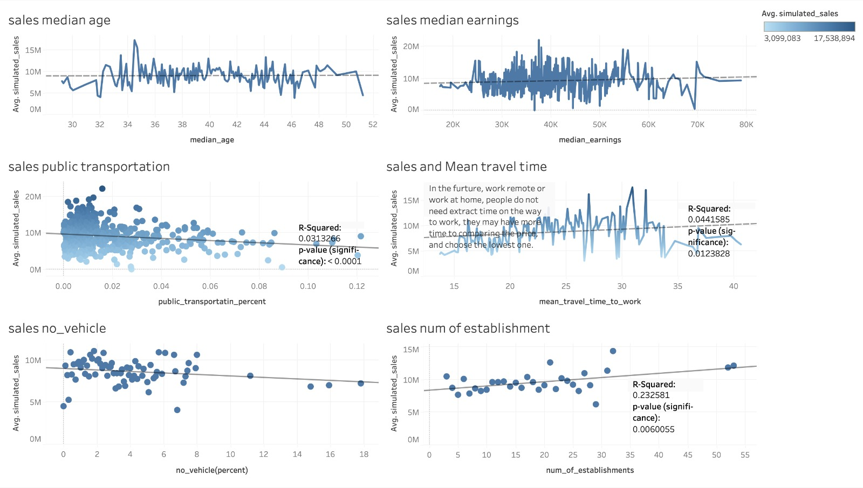

Slide 27
Analysis
Multi collinearity
Linear Regression
Random Forest

Slide 28
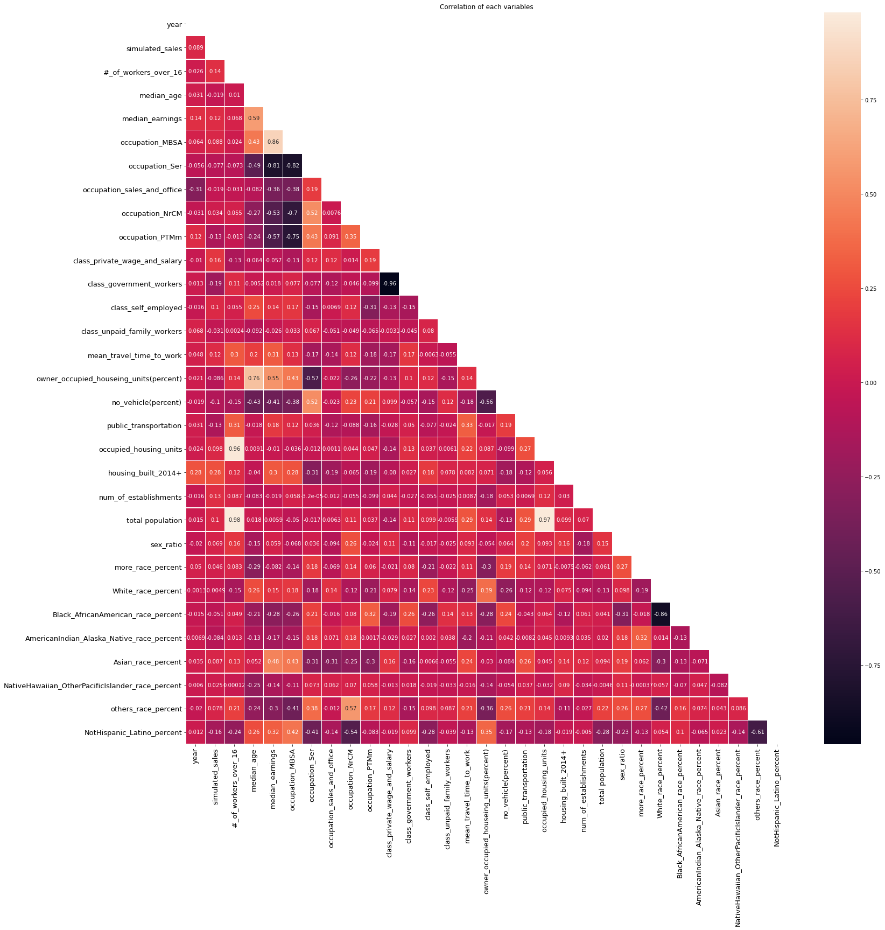
Correlation matrix for predictor variables

Slide 29
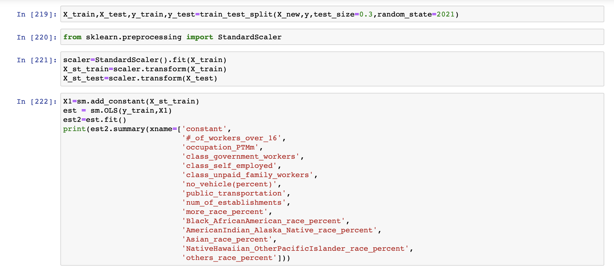
Linear Regression

Slide 30
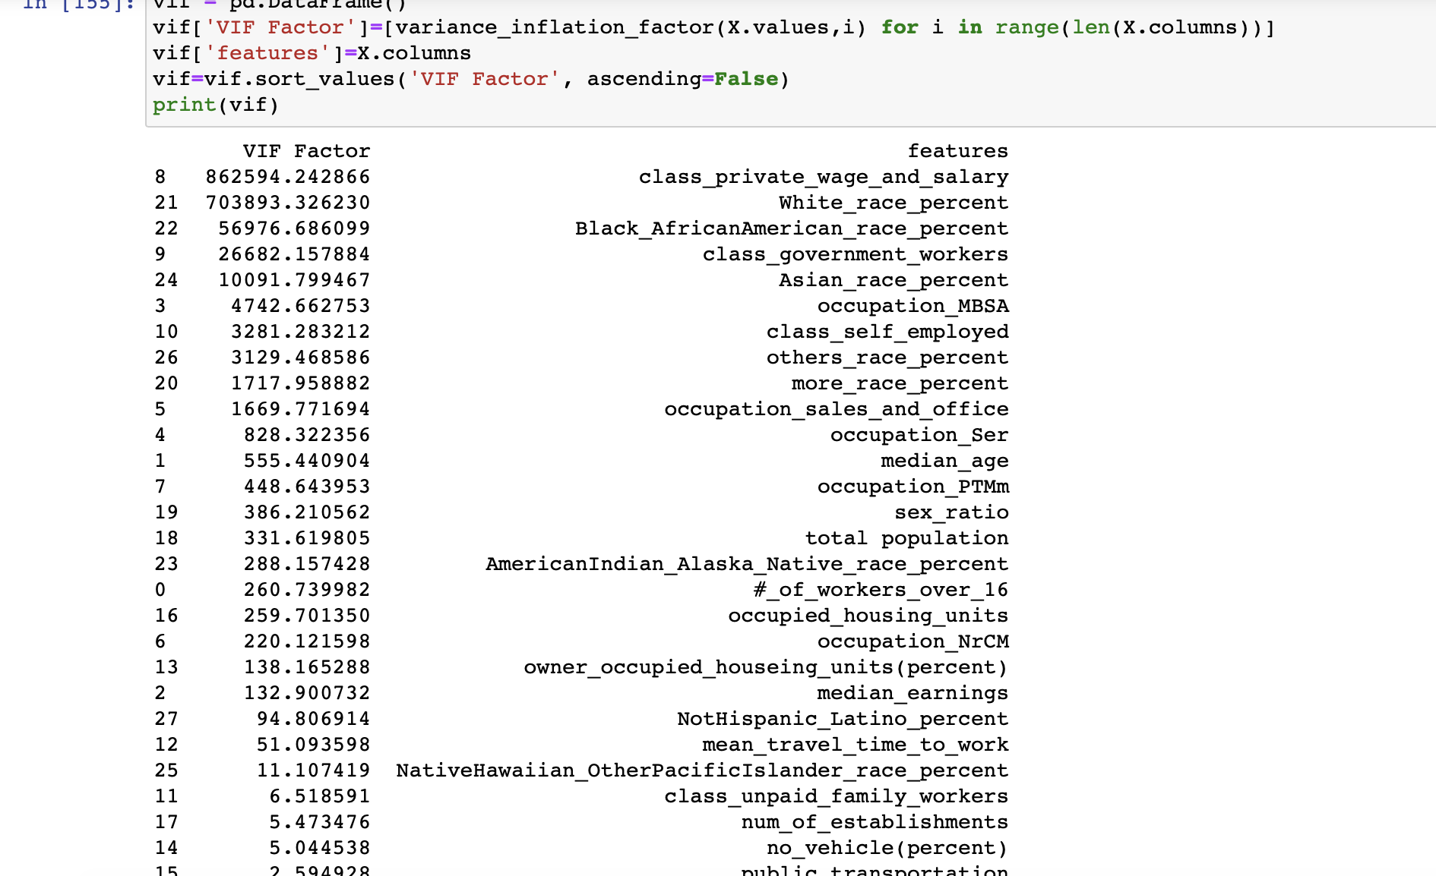
A co-linearity measurement of the predictor variables inside a many regression is the Variance Inflation Factor (VIF). The ratio of variance of all beta parts of a given model to the variable of one beta, assuming they fit all alone, will be computed.
VIF Implementation Steps
-Run a regression multiple.
-The VIF factors are calculated.
-Inspect the components for each variable with the predictor if the VIF is 5-10, multi-co-linearity probably exists and the variable should be dropped.
VARIANCE INFLATION FACTOR (VIF)

Slide 31
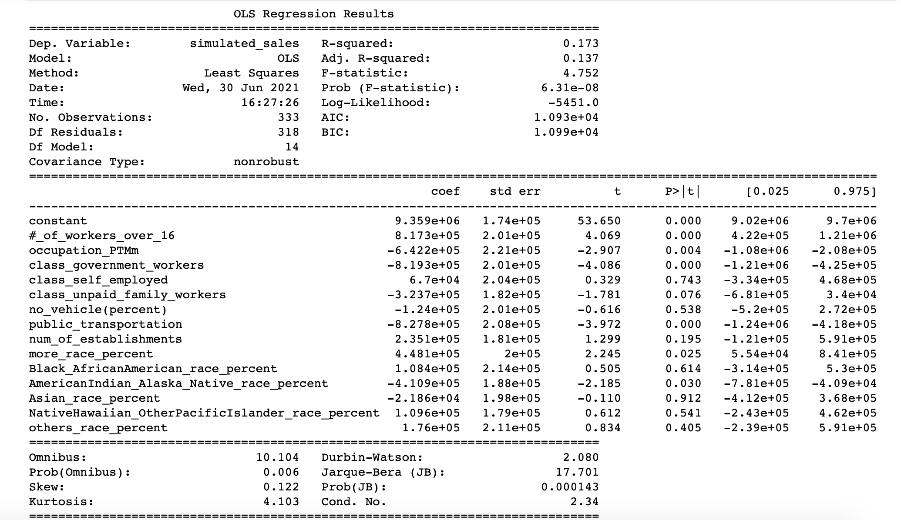

Slide 32
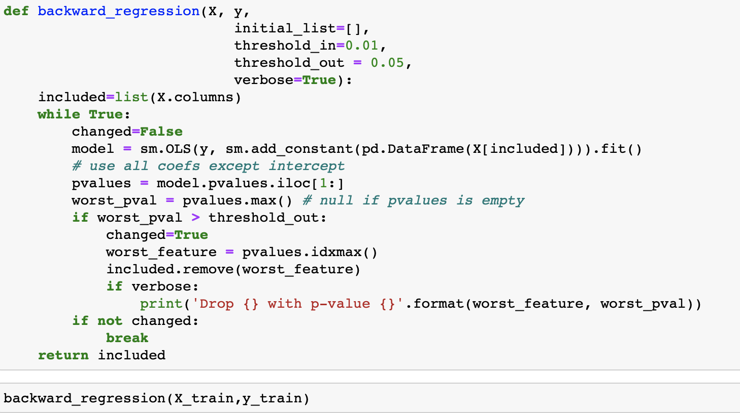
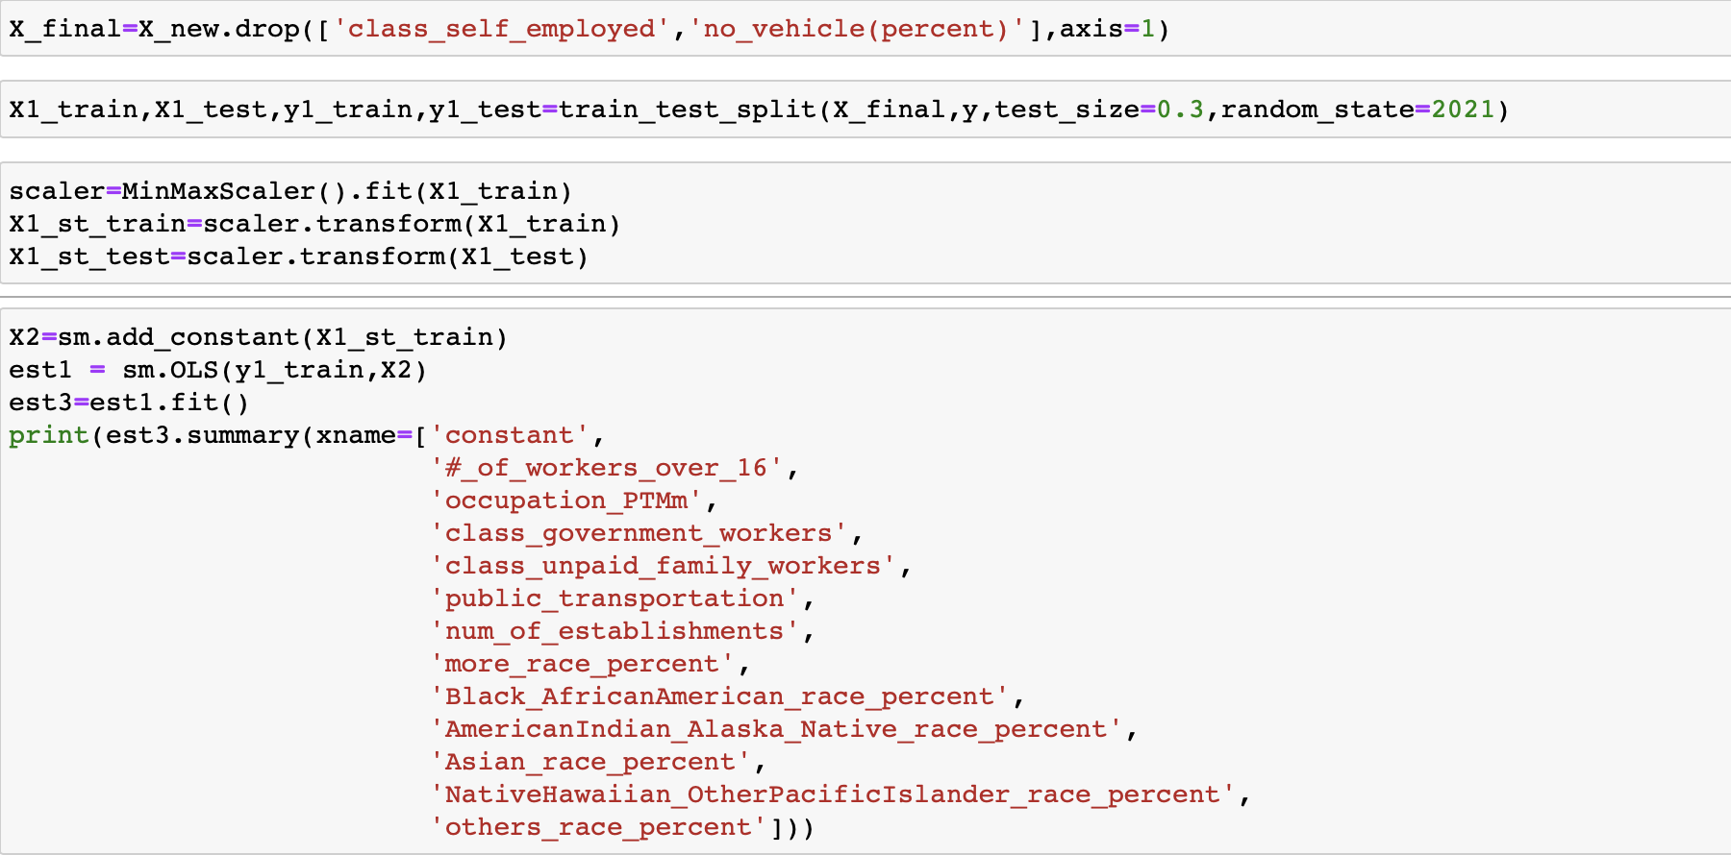
BACKWARD STEPWISE REGRESSION
Regression step-by-step backward is a step-by-step (saturated) regression technique that begins with the complete model and phases the variables from the regression model to discover a smaller model to describe the most detailed data in each stage. Also known as regression of Backward Elimination.

Slide 33
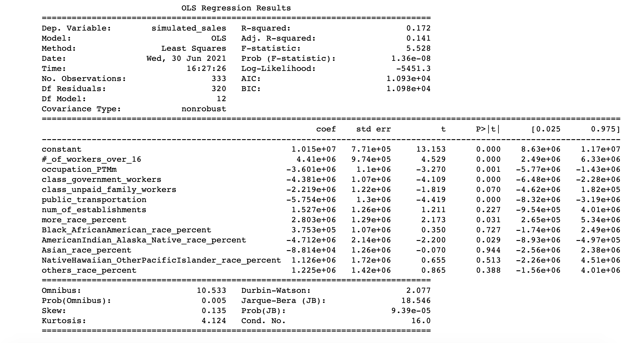

Slide 34
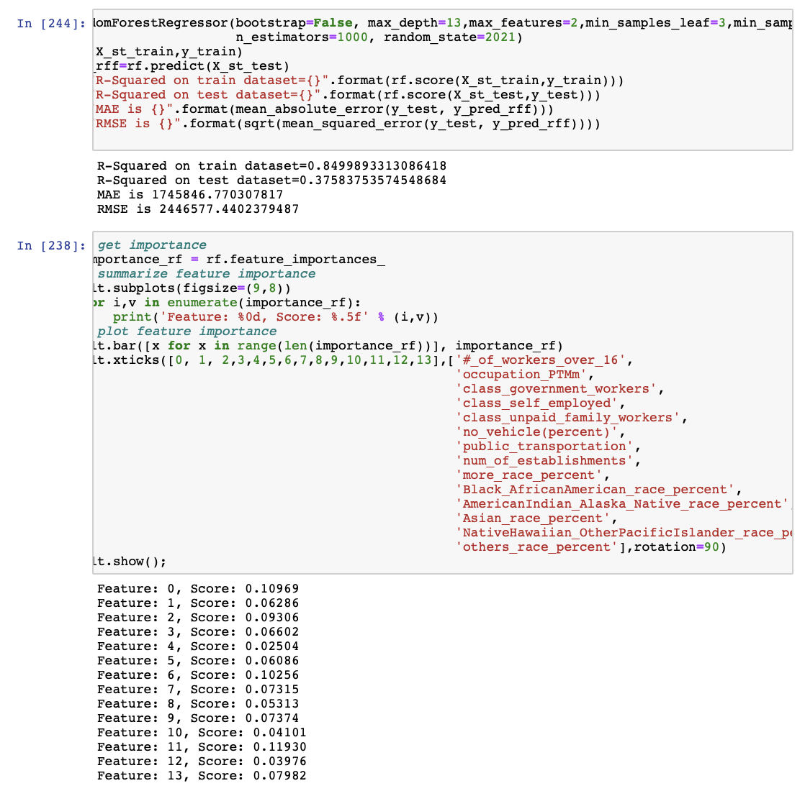
Random Forest

Slide 35
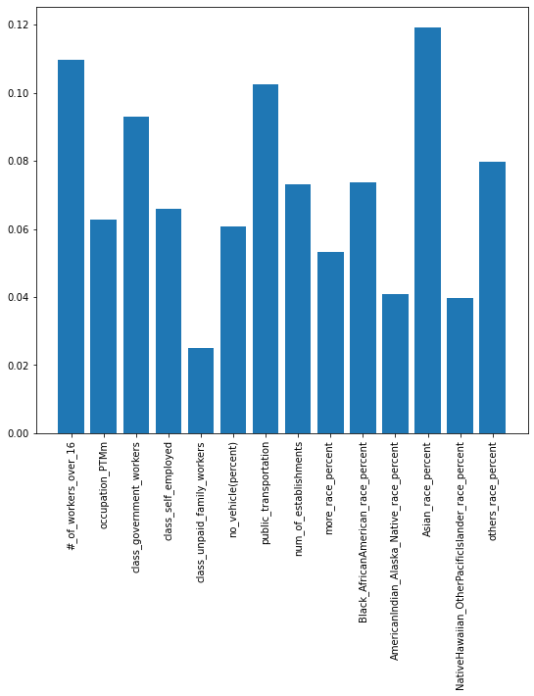
Important features:
1. Asian_race_percent
2. #_of_workers_over_16
3. public_transportation
4. class_government_workers

Slide 36
Business Recommendations
When choosing location of AHG stores needs to pay attention to class of work. Try to choose areas with a smaller proportion of government workers.
Areas with more developed public transportation systems may not be a good choice for AHG offline stores.
The location of AHG offline stores could be selected in the commercial circle where some home décor stores gathered.
For the establishment of a more accurate sales forecast model in the future, the Asian race ratio is a point worthy of attention.

Slide 37
Reference
Adam Wilk. (2021). At Home Group's Share Price Can Double, Says Portfolio Manager. Barron's (Online).
Bailey AA (2008) Evaluating consumer response to EDLPs. J Retail Consum Serv 15(3):211–223
Bell DR, Lattin JM (1998) Shopping behavior and consumer preference for store price format: why ‘‘large basket’’ shoppers prefer EDLP. Mark Sci 17(1):66–88
Gauri DK, Trivedi M, Grewal D (2008) Understanding the determinants of retail strategy: an empirical analysis. J Retail 84(3):256–267
Monroe KB (2003) Pricing: making profitable decisions, 3rd edn. McGraw-Hill, New York
Chriscaden, K. (2021). Impact of COVID-19 on people's livelihoods, their health and our food systems. World Health Organization. https://www.who.int/news/item/13-10-2020-impact-of-covid-19-on-people's-livelihoods-their-health-and-our-food-systems.
Danziger, P. N. (2020, August 30). COVID Shutdowns Crushed Home Furnishings And Furniture Stores. The Squeeze Will Continue. Forbes. https://www.forbes.com/sites/pamdanziger/2020/08/30/covid-shutdowns-crushed-home-furnishings-and-furniture-stores-the-squeeze-will-continue/?sh=1fd615ef20ca.
Lal R, Rao R (1997) Supermarket competition: the case of every day low pricing. Mark Sci 16(1):60–80
Popkowski Leszczyc PTL, Sinha A, Sahgal A (2004) The effect of multi-purpose shopping on pricing and location strategy for grocery stores. J Retail 80(2):85–99
Pechtl H (2004) Profiling intrinsic deal proneness for HILO and EDLP price promotion strategies. J Retail Consum Serv 11(4):223–233
Tang CS, Bell DR, Ho T-H (2001) Store choice and shopping behavior: how price format works. Calif Manag Rev 43(2):56–74

Slide 38
Reference
United States Home Decor Market Size, Share: Industry Analysis 2021 to 2026 With COVID Impact – Mordor Intelligence. United States Home Decor Market Size, Share | Industry Analysis 2021 to 2026 With COVID Impact – Mordor Intelligence. (2021). https://www.mordorintelligence.com/industry-reports/us-home-decor-market.
Formats*: (2021). Home Decor Market Size, Share and Trends: Analysis Forecast - 2027. Allied Market Research. https://www.alliedmarketresearch.com/home-decor-furnishing-market.

